Slide 1
111321534
莊璧如

Slide 2
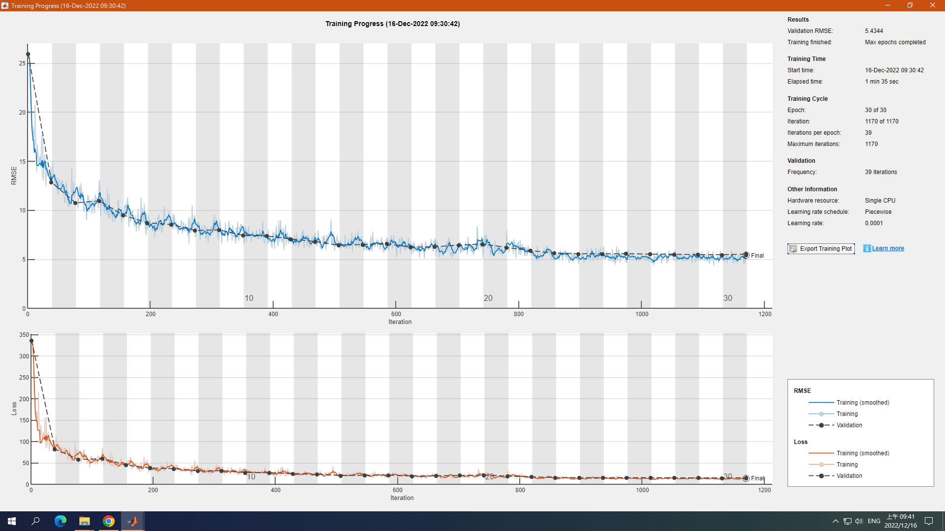
Ex1 average pooling

Slide 3
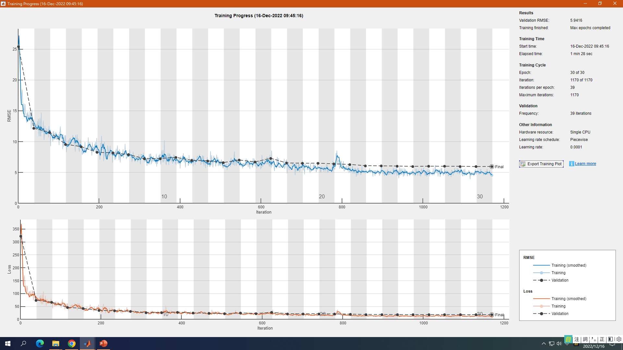
Max pooling

Slide 4
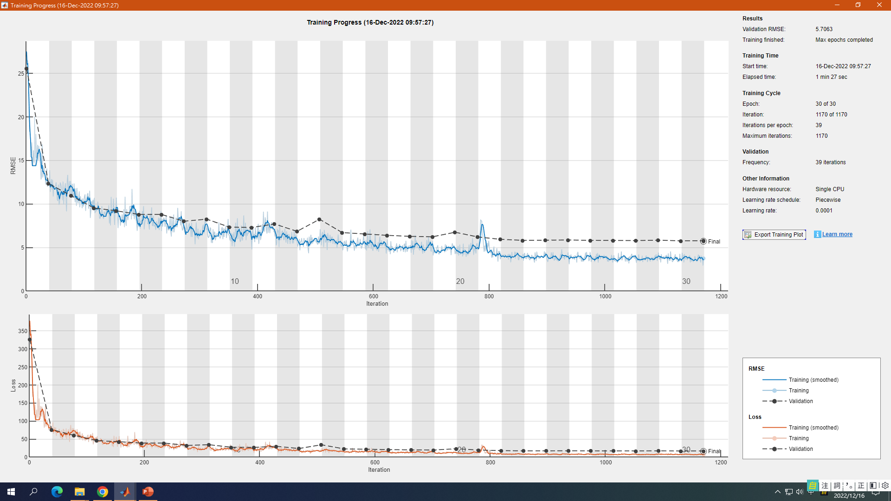
Max pooling 拿掉dropout

Slide 5
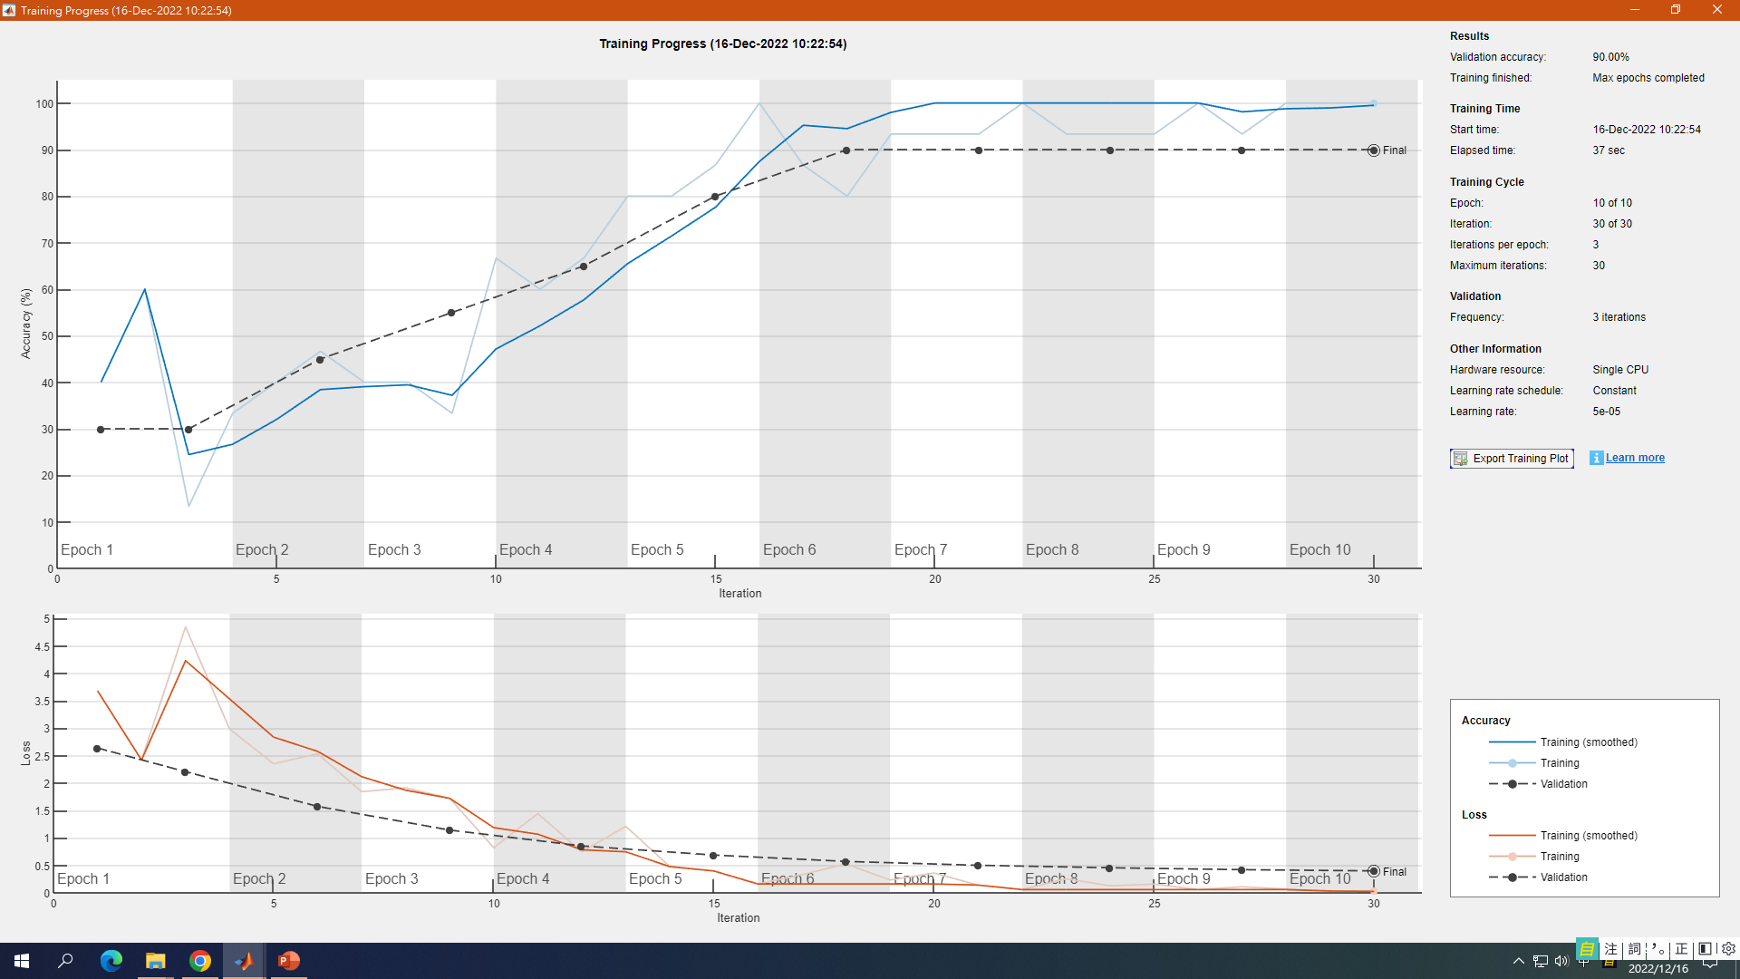
alexnet

Slide 6
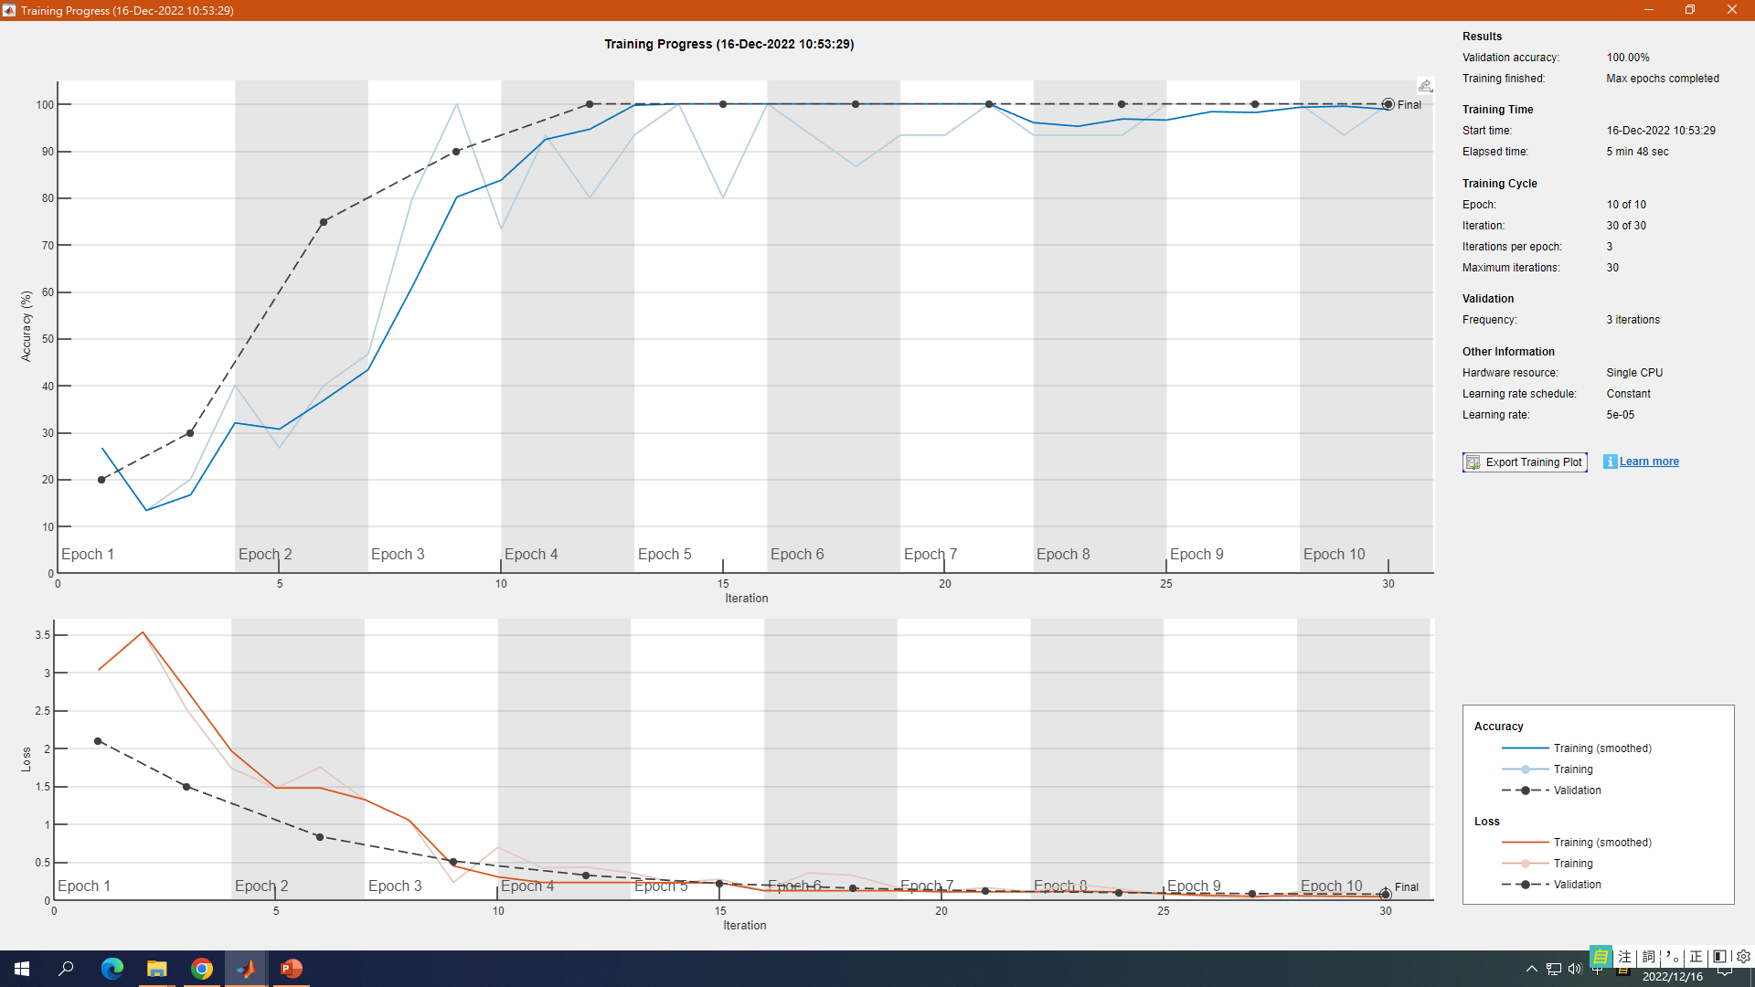
將alex net改成vgg16

Slide 7
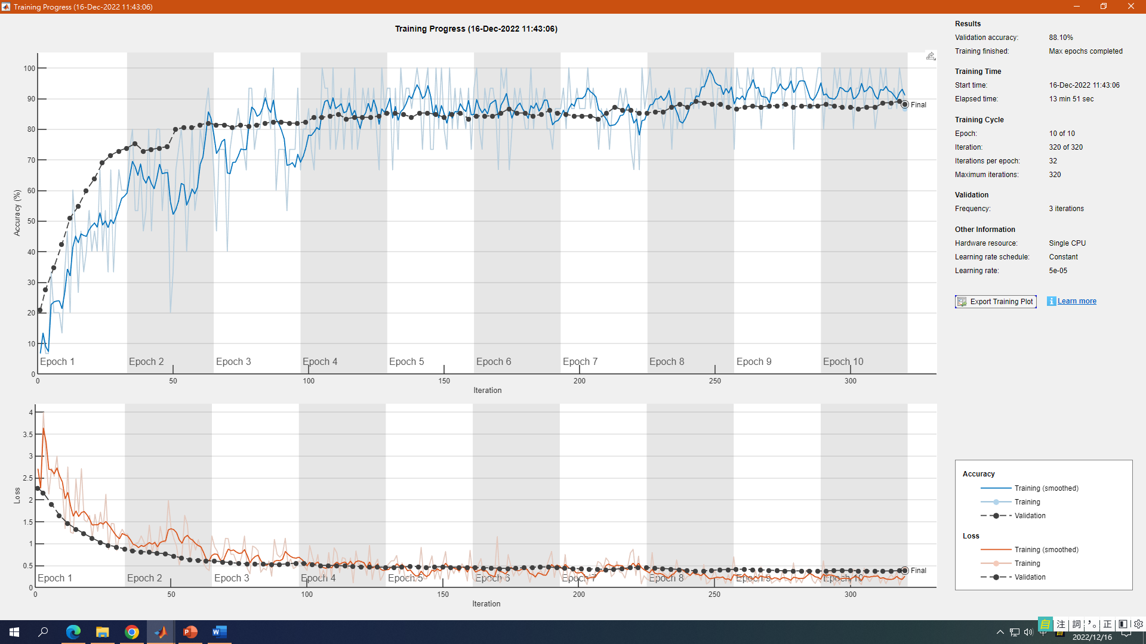
small_EUROSat跑alexnet

